Slide 1
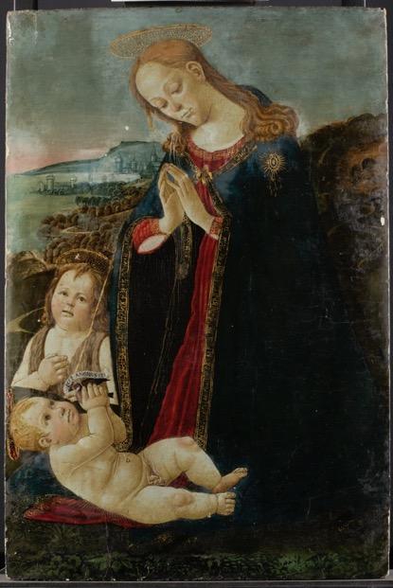
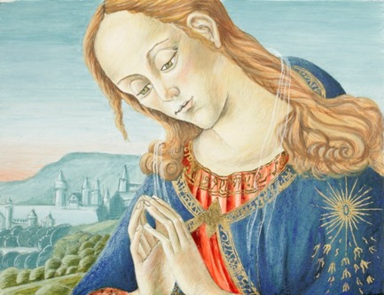
Reconstructing Jacopo del Sellaio’s techniques and materials Virgin adoring the Child c. 1473 The Fitzwilliam Museum
© Fitzwilliam Museum
The original painting
Reconstructions by Joanna Neville and Rowan Frame, Hamilton Kerr Institute
Notes:
Joanna and I are training to be paintings conservators.
Reconstructing paintings using historically-informed materials and methods is part of our training.
Understanding as much as possible about how paintings were made and what they are made from helps when conserving and restoring them.
We recently reconstructed a section of another of Jacopo del Sellaio’s paintings to understand his techniques.
Our reconstructions look different to the original painting. Our reconstructions resemble how the painting may have looked when it was first made, roughly 500 years ago, whereas Sellaio’s original has suffered the effects of time. In the past Sellaio’s painting probably looked much more vibrant.

Slide 2
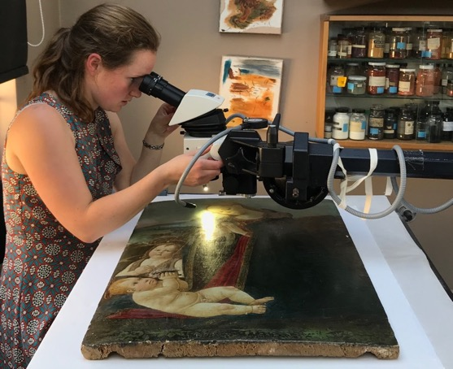
How did we find out how Sellaio painted?
© Fitzwilliam Museum
Contemporary sources, eg Cennino Cennini’s writing
Looking closely
Imaging techniques
eg infra-red
Notes:
Recipes and manuals written around the same time Sellaio was painting gave us an idea about the kind of techniques Sellaio may have used. For example, a manuscript about art written by another 14^{th—}15th century Florentine artist, called Cennino Cennini, was very useful to us.
It was possible to how Sellaio’s painting progressed by looking at how brushstrokes overlap one another.
We could also look at paint layers invisible to the naked eye by photographing the painting under different kinds of light, like ultraviolet and infra-red light.

Slide 3
How we reconstructed Sellaio’s painting
The ground
The underdrawing
The paint
The gilding
Notes:
In the next few slides we’d like to share with you how we recreated Sellaio’s Virgin Adoring the Child using materials and methods as close as possible to those the artist would have used.
Quotes used in this presentation are taken from Lara Broeck’s English translation of Cennino Cennini’s Il Libro Dell’Arte
Cennino, C. 2015. Il Libro Dell’arte (L. Broecke, trans.) London: Archetype Publications Ltd.

Slide 4
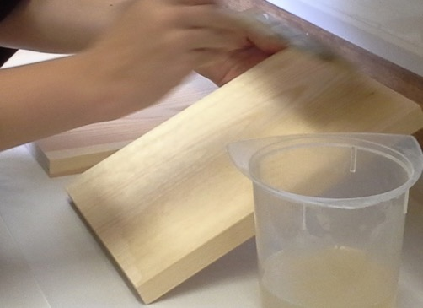
The glue size layer
‘So this glue is: it is an appetiser for the wood to take up the glues and gessoes’
(Cennino, 15th century)
The glue size prevents glue from the gesso soaking into the wood causing the gesso to dry out … and flake off!
Notes:
First of all, we coated our wooden supports in warm animal skin glue, just as Cennino recommends in his recipes.
This layer stops the wood absorbing liquid from the next layers.
Quote (Cennini 2015: 109, 143)

Slide 5
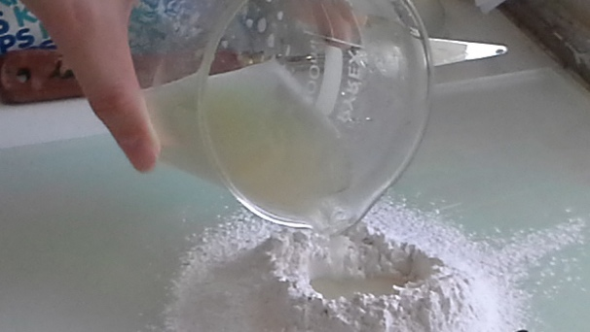
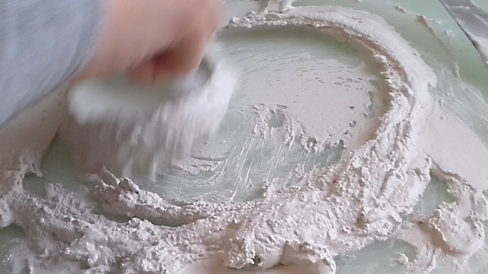
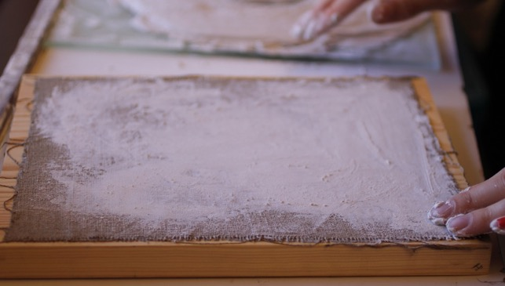
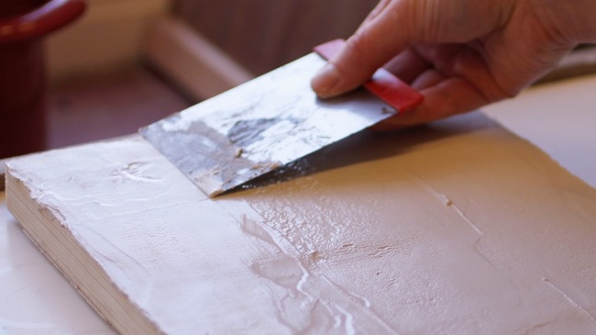
The gesso grosso layer
‘Then get gesso grosso (that is, from Volterra) […]’
‘[…] and start covering all of the flats with it using a fairly large and completely flat palette knife’
(Cennino, 15th Century)
Notes:
In order to make the wood a more suitable surface to paint on, the artist’s workshop would have applied a a white ground layer, called gesso.
Sellaio would have used a locally available material — gypsum, or ‘gesso’ in Italian — mixed with animal skin glue for his first gesso layer – the gesso grosso
Plaster of paris is very similar to gypsum, so we we mixed Plaster of Paris with animal skin glue, and spread it onto the surface.
For large works, like Cupid and Psyche, Sellaio applied a layer of linen before the gesso to stabilise joins and even out imperfections in the wood.
Quote (Cennini 2015: 115, 150).

Slide 6
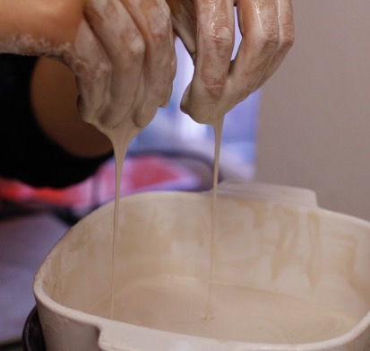
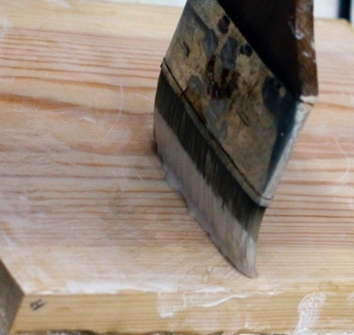
The gesso sottile layers
‘[…] this same gesso but it is purified for a good month, kept soaking in a tub.’
‘[…] apply a layer all over with a brush […] Then let it rest a little, but not so long that it completely dries out […]’
(Cennino, 15th century)
Notes:
While the gypsum—glue mixture is fine for the initial layer of gesso ground, the mixture is quite coarse and rough.
To get an even smoother surface to paint on, Sellaio would have applied further layers of what was known as ‘gesso sottile’.
As Cennino tells us, gesso sottile comes from the same starting material gesso grosso, but is soaked for a month in water. The gypsum reacts with the water (it hydrates) and smaller, finer crystals reform.
This process, known as slaking, highlights how much early Italian artists’ knew about the materials they used and were able to manipulate them to achieve their desired properties.
After soaking some Plaster of Paris, we dried the mixture out, mixed it with animal skin glue until runny, and then painted it thinly over the gesso grosso.
The right-hand photo shows the sottile painted over the bare wood, just to show you how thin the layers were.
We applied eight layers of gesso sottile. According to Cennino’s recipes, it was important to wait until the layer below was almost dry, but not completely dry, before applying the next layer.
Quote (Cennini 2015: 116, 152-154).

Slide 7
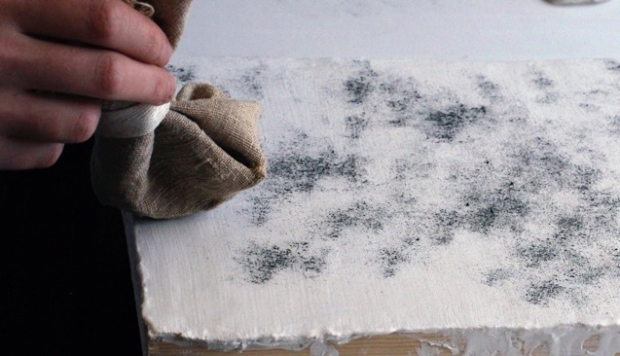
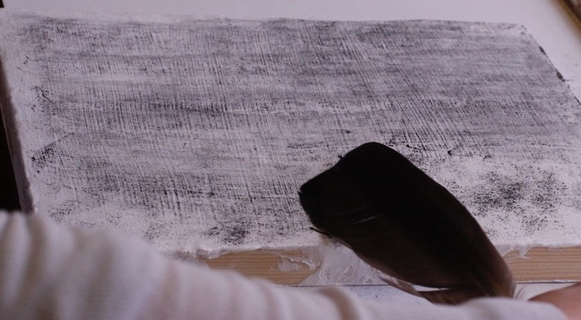
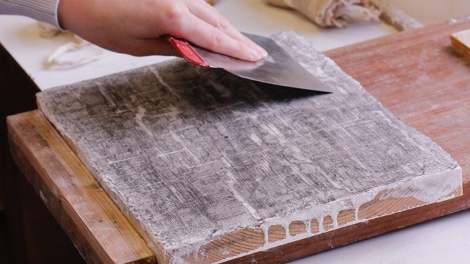
Smoothing the gesso
‘Get a rag with ground charcoal, tied up in a little ball, and start dusting over the surface […]
Then, with a bunch of goose or hen feathers, start sweeping this black dust […]’
‘[…] where you remove the gesso it comes out white as milk […]’
(Cennino, 15th century)
Notes:
Cennino suggests dusting charcoal powder over the dried gesso sottile and sweeping it into the texture with a feather to see where the gesso needs smoothing.
The idea is to scrape and rub the panel smooth until you can no longer see any charcoal
It surprised us how time consuming and physically demanding it was to simply prepare the panel for painting. The process I’ve described so far took us several days. It’s likely that the original painting was a collaborative effort, and that Sellaio would have employed workshop assistants to complete these steps.
Quote (Cennini 2015: 121, 157).

Slide 8
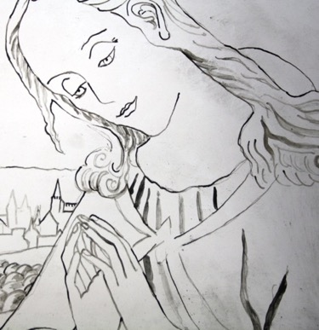
The underdrawing
Normal light image
Infra-red image
Reconstruction of what the underdrawing may have looked like
Notes:
After smoothing the gesso, the panel was ready to draw and paint on.
The dark outlines seen in an infra-red image of the painting may indicate where the design was outlined in a carbon-containing material by Sellaio before it was painted.
Sellaio painted a number of very similar paintings to this one, so it is likely his workshop reused a template for the design, known as a cartoon, and traced it onto the panel, rather than drawing or painting freehand.

Slide 9
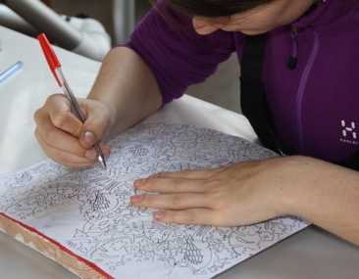
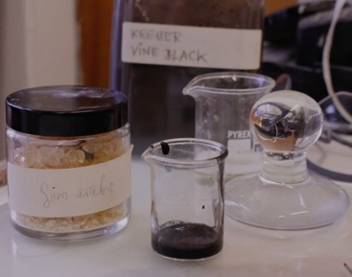
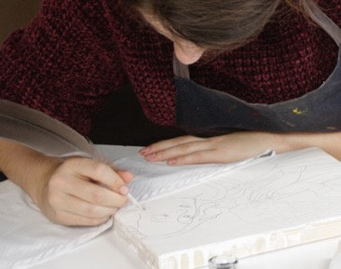
The calco transfer method
‘Then get a wash of the ink and start shading some folds and some shadows in the face with quite a blunt vair brush. And in this way you will come out with a delightful drawing so that everyone will fall in love with your creations’
(Cennino, 15th century)
Notes:
One way the artist’s workshop could have transferred their design would have been to dust charcoal onto the back of their paper cartoon, to place the charcoal side down onto the panel, and to then press over the lines with a sharp tool.
This transfer method is called ‘calco’.
We found that this method worked well, and left clear, clean lines of charcoal on the panel.
After this, we reinforced our charcoal drawing with quills and ink that we made by grinding charcoal in gum Arabic dissolved in water
Quote (Cennini 2015: 122, 158)

Slide 10
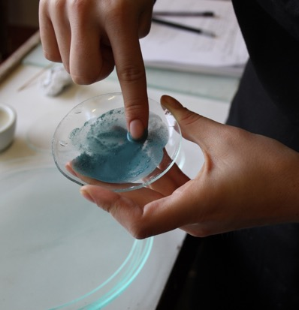
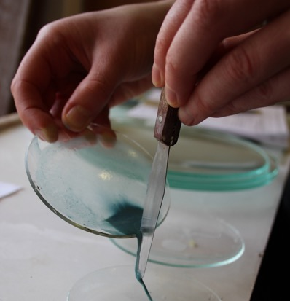
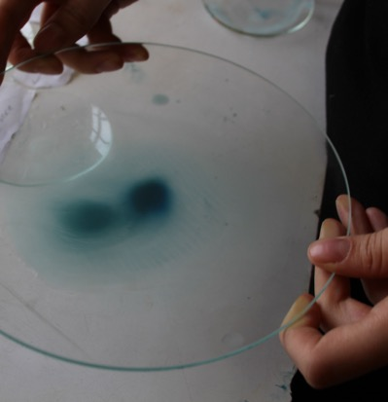
Processing pigments

Slide 11
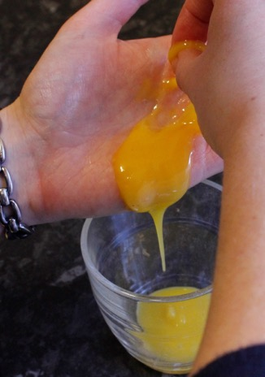
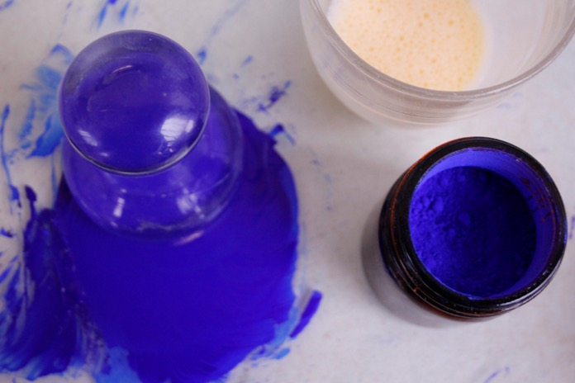
Making egg tempera paint

Slide 12
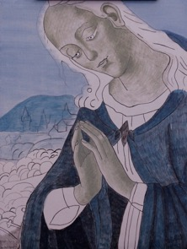
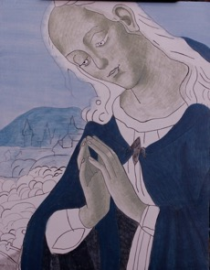
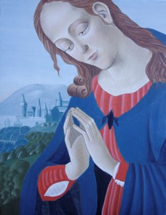
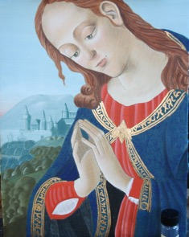
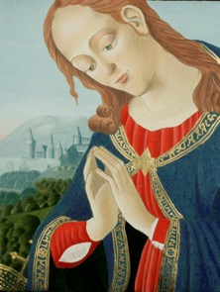
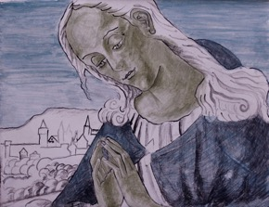
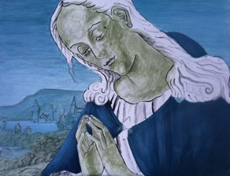
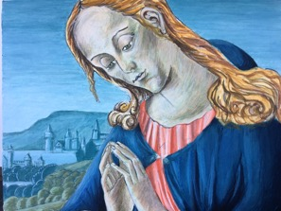
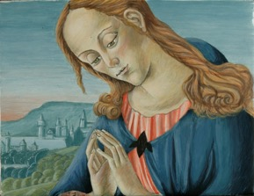
Step by step

Slide 13
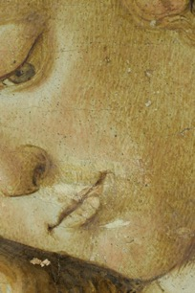
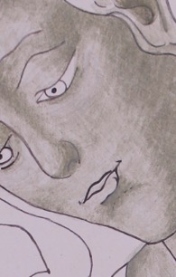
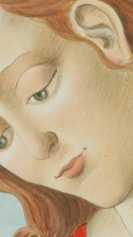
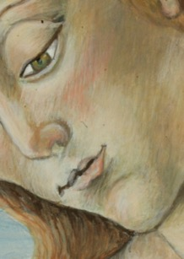
Verdaccio
‘Not, however, encroaching so much on the shadows in verdaccio that you cover them up completely’ (Cennino, 15th century)

Slide 14
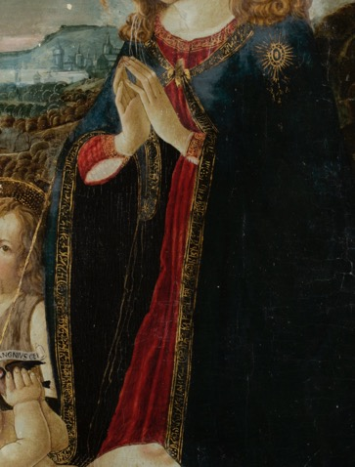
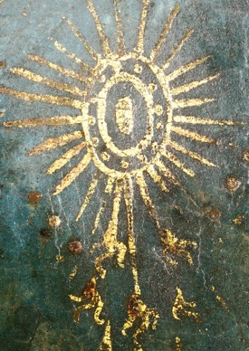
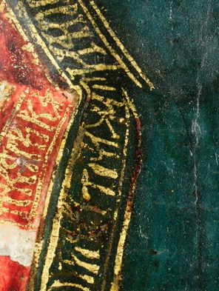
Gilding
Notes:
Where gold abraded, can see Sellaio mordant red, Blondeel mordant yellow
Tones gold, tears not obvious, make gold warmer colour
Don’t know composition of mordants, but sources:
C recipe: stand oil, varnish, lead white, verdigris and bole
Strasbourg M: ochre, Armenian bole, red lead, varnish, zinc vitriol
B X-section: lead white, yellow ochre, pale blue azurite or smalt
Examination of surface – gritty particles in mordant
Areas where the gold has rubbed away on Sellaio’s painting show a red-coloured mordant.
We don’t know the exact composition of the mordants. Sellaio’s might resemble the mordant Cennino describes: to boil together linseed oil pre-polymerised by boiling or leaving to stand in the sun, a little varnish, and some lead white and Verdigris as driers. To further aid drying, Cennino recommends adding ‘a smidgeon of bole’. To create a mordant you can apply and come back to ‘whenever you like’ to gild, presumably after reactivating with some moisture, he recommends ‘middle-aged’ garlic, lead white and bole, with the addition of some urine before application (Cennini 2015: 164–166, 195—198). During her reconstruction of a crucifix, Broecke found that the best drying oil mordants were 10ml lead oil and 1g verdigris or 0.5g bole, ground and heated to 110C, with 1ml vernice comune then added and left for one to three days. She found Cennino’s recommendation for heat-bodied oil too sticky (Breocke 2010: 68). Apart from aiding drying, the bole would help impart a warm colour to the gold.
The gold on The Virgin with St Anne appears to be applied to an oil paint layer rather than to any bole. Where visible, the oil mordant is yellow, presumably to tone the gold and to ensure any tears in the gold are not obvious. Cross-sections suggest that the oil mordant contains lead white, yellow ochre and some pale blue that could be azurite or smalt. On microscopic examination of The Virgin with St Anne, gritty particles that have worn through the gold are apparent, suggesting the artist used a slightly mordant containing gritty pigment particles, probably the earths.

Slide 15
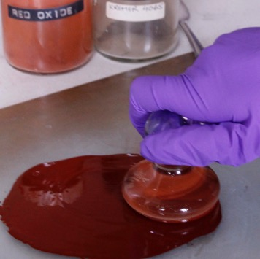
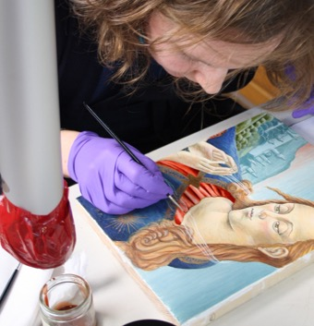
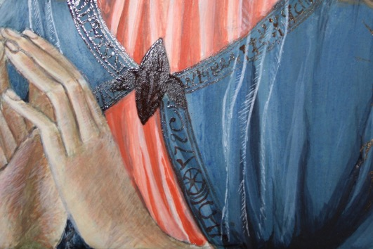
Oil mordants
Notes:
For N: aged glair used to adhere gold, but for others, oil mordant
Authentic S mordant not made – time constraints
But added raw umber and red oxide to match colour
Pigment reduced flow made it more difficult to work
Mordant likely to be applied freehand – underdrawng no longer visible – B says chalk wicks mordant
C: brush ‘stiff and pointed and so that the tip protrudes just a tiny bit from the shaft’ & ‘ensure the brush is not overloaded’– proved good advice
For B, yellow ochre, white, sienna and azurite in leaded oil used
Due to time constraints, a mordant composition similar to what Sellaio is likely to have used was not reconstructed here. A modern fast-drying (1—2 hour) mordant containing cobalt manufactured by A. S. Handover was used, but a little raw umber and red oxide pigment were added to at least achieve a similar surface colour to what can be seen on the original painting. Tests with colourless and with red-coloured mordant showed a clear difference in final gild colour, the red mordant giving a closer colour to the gold in Virgin adoring the Child painting. Only very little pigment could be added though, as the pigment reduced the flow of the mordant and made it more difficult to brush out.
The gilded patterns were applied freehand with no underdrawing. Cennino’s instruction to use a brush ’stiff and pointed and so that the tip protrudes just a tiny bit from the shaft‘ for applying the mordant proved sound — a shorter tip made for a much neater application than a longer tip brush. He also helpfully recommends to ‘ensure the brush is not overloaded’, I found otherwise line widths are inconsistent and uncontrollable (Cennini 2015: 164, 195).
The Strasbourg Manuscript contains a recipe for preparing an oil gilding ground that contains ingredients that are likely to be similar to the ones Blondeel used: ‘Take two parts of ochre and the third of Armenian bole and the fourth part of red lead and grind all together on a grinding stone with linseed oil’. The manuscript also recommends adding white bone and zinc vitriol as siccative and ‘half a shell’ of varnish to the mixture (Neven 2016: 90, 131). The next recipe in the Strasbourg Manuscript describes applying this mordant directly onto glue-sized wood (Neven 2016: 91, 133). For the reconstruction, however, a simpler mixture of yellow ochre and lead white with a touch of sienna and azurite in leaded oil — with a slightly thicker consistency than the priming paint — was applied to the areas to be gilded, which were aleady pre-prepared with ground and priming layer. The vitriol ingredient that the Strasbourg Manuscript suggests would have speeded drying and the varnish ingredient is likely to have prevented brushmarks in the mordant (although this did not seem a problem without varnish).
For the water gilding, aged glair was used to adhere the gold. True to Cennino’s method, egg whites (two eggs) were separated and whisked until they formed ‘stiff foam that looks like snow’ (Cennini 2015: 131, 164) (Figure 2.1). Cennino instructs to add ‘a normal beaker, not too big, not quite full of completel­y clear water’ (Cennini 2015: 131, 164). So, assuming a beaker in 15th century Italy may have been a similar size to a modern coffee cup, an amount of water roughly equalling half the amount of egg white was added. Cennino recommends leaving the glair to ‘rest and settle from the evening to the morning’ (Cennini 2015: 131, 164), presumably to let the air bubbles escape and to let the liquid get stickier as proteins begin to denature and expose more polar protein side-groups. The same glair, but a little diluted, was used to adhere the gold as had been used to bind the bole, and by the time of the gilding step it had had chance to age.
Whereas the oil mordants were applied and left to dry for some time, the glair was applied to small areas immediately before applying the gold. The glair dries initially by evaporation of water, which is quick, whereas the oil mordants dry by pigment-catalysed polymerisation of the oil medium, which takes longer.

Slide 16
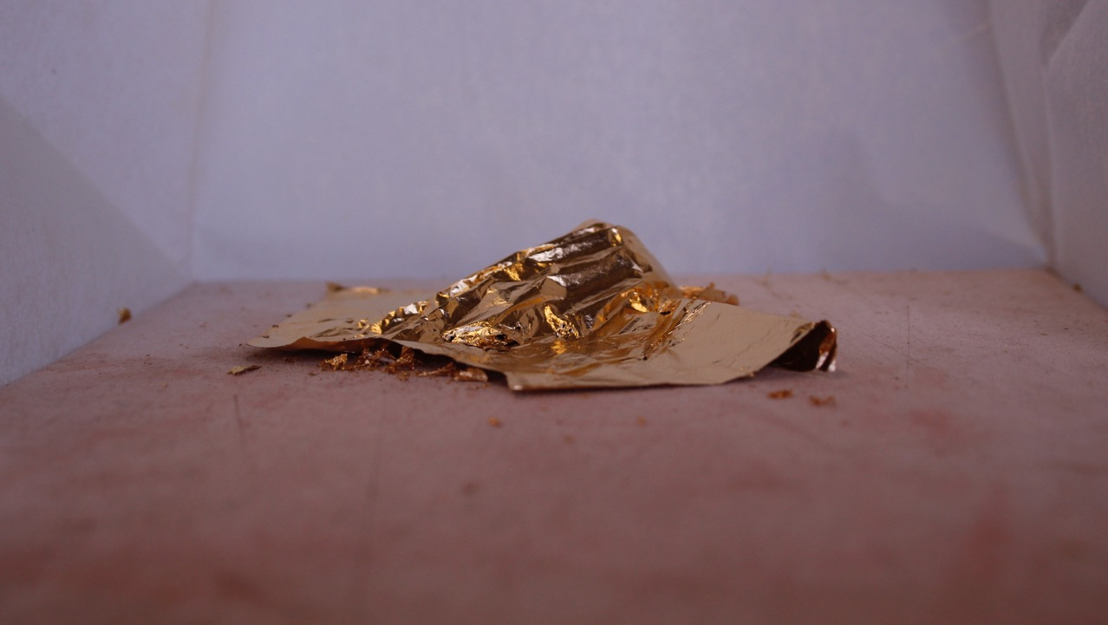
Gold leaf
‘When mild, wet weather arrives and you want to gild …’
(Cennino, 14th century)
Notes:
Environment had significant influence on timing, difficulty, success
Draught-free and humid better
C: ‘in winter you can gild as much as you want while
We realised that the artists’ environment will have had a significant influence on the difficulty and success of the artists’ gilding steps. A more humid environment may have made manipulating and burnishing gold easier. It may have been easier to pick up on the gilder’s tip. A draught-free environment also helps with controlling the free gold leaf.

Slide 17
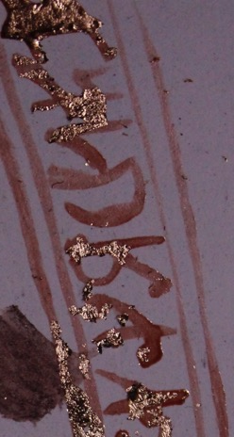
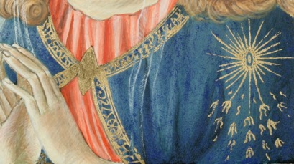
Applying the gold leaf
Removing excess gold
Notes:
C: pat down with cotton and work away excess with fingertips. We found better with a soft brush
Needed to leave mordant to be fully dry first
Strasbourg: ‘After that, rub the gold everywhere with wool, then the gold is taken away where the ground is not applied’. Used cotton wool on Blondeel panel
Didn’t need to remove excess from water-gilded panel, but this did need to be burnished
Burnished same day gold applied, about 3 hours later
Tricky not to mark grooves into gold – begin lightly then increase
C: Rubbing burnished on clothes first may have helped
What are we looking for? C: when the gold comes out almost dark, it is so shiny’
Removing excess gold
Cennino also suggests patting it down with cotton wool and working away excess with fingertips. In fact, patting down and working away excess was more successful using a soft brush, and after leaving the mordant enough time to fully dry first. The method for gilding is similarly described in the Strasbourg Manuscript: ‘then cut the gold … and lay them one next to the other, where the ground is. Press delicately the gold with cotton onto the ground until it is well covered everywhere with gold or silver. After that, rub the gold everywhere with wool, then the gold is taken away where the ground is not applied’ (Neven 2016: 91, 133). Rather than using cotton, then wool, cotton wool was used in on the Blondeel reconstruction for both these steps.
Burnishing the Nardo gold
Of course, we didn’t need to remove any excess gold from the water-gilded panel, but this gold did need to be burnished, unlike the oil-gilded panels. According to Cennino, suitable materials for burnishing gold are iron ore rock, sapphires, emeralds, balas rubies, topazes, rubies, garnets, and the teeth of ‘any animal that feeds finely on meat’ (Cennini 2015: 135, 170). A canine tooth-shaped agate burnisher was used on the reconstructions, which is hard and smooth like the burnishers Cennino recommends.
The reconstructions were burnished the same day the gold was applied, around three hours later. It was tricky not to mark grooves into the gold with the burnisher. It was necessary to begin very lightly and increase the pressure gradually over the same areas. Rubbing the burnisher on clothes before applying it to the gold, as Cennino recommends, may have helped by heating the burnisher a little (Cennini 2015: 138, 173). Helpfully, Cennino gives some idea of when enough burnishing is enough: ‘when the gold comes out almost dark, it is so shiny’ (Cennini 2015: 138, 173). According to Cennino, ‘in winter you can gild as much as you want while the weather is damp and mild and not dry. In summer, gild one hour, burnish the next.’ This must be because burnishing is more likely to mark the gold rather than polish it if the bole is allowed to become too dry.

Slide 18
